Slide 1
K Nearest Neighbors Trials
Trial 1– 120 runs
5 feature subsets
3 Target Discretization Strategies
Range, Frequency, k means
4 bin sizes to discretize targets into
3, 8, 12, 20
2 choices for k
5, 87
Trial 2– 600 runs
5 feature subsets
2 Target Discretization Strategies
Frequency
Equal Range on log(hours_played)
20 bin sizes to discretize targets into
[ 5 10 15 20 25 30 35 40 45 50 55 60 65 70 75 80 85 90 95 100]
3 choices for k
5, 100, 1000

Slide 2
F=all_T=freq_GROUP=3_K=5
F=all_T=freq_GROUP=8_K=5
F=all_T=freq_GROUP=12_K=5
F=all_T=freq_GROUP=20_K=5
F=chi_test_T=freq_GROUP=3_K=5
F=chi_test_T=freq_GROUP=8_K=5
F=chi_test_T=freq_GROUP=12_K=5
F=chi_test_T=freq_GROUP=20_K=5
F=textblob_extra_T=freq_GROUP=3_K=5
F=textblob_extra_T=freq_GROUP=8_K=5
F=textblob_extra_T=freq_GROUP=12_K=5
F=textblob_extra_T=freq_GROUP=20_K=5
F=textblob_T=freq_GROUP=3_K=5
F=textblob_T=freq_GROUP=8_K=5
F=textblob_T=freq_GROUP=12_K=5
F=textblob_T=freq_GROUP=20_K=5
F=vote_count_T=freq_GROUP=3_K=5
F=vote_count_T=freq_GROUP=8_K=5
F=vote_count_T=freq_GROUP=12_K=5
F=vote_count_T=freq_GROUP=20_K=5
F=all_T=freq_GROUP=3_K=87
F=all_T=freq_GROUP=8_K=87
F=all_T=freq_GROUP=12_K=87
F=all_T=freq_GROUP=20_K=87
F=chi_test_T=freq_GROUP=3_K=87
F=chi_test_T=freq_GROUP=8_K=87
F=chi_test_T=freq_GROUP=12_K=87
F=chi_test_T=freq_GROUP=20_K=87
F=textblob_extra_T=freq_GROUP=3_K=87
F=textblob_extra_T=freq_GROUP=8_K=87
F=textblob_extra_T=freq_GROUP=12_K=87
F=textblob_extra_T=freq_GROUP=20_K=87
F=textblob_T=freq_GROUP=3_K=87
F=textblob_T=freq_GROUP=8_K=87
F=textblob_T=freq_GROUP=12_K=87
F=textblob_T=freq_GROUP=20_K=87
F=vote_count_T=freq_GROUP=3_K=87
F=vote_count_T=freq_GROUP=8_K=87
F=vote_count_T=freq_GROUP=12_K=87
F=vote_count_T=freq_GROUP=20_K=87
KNN Classifiers which perform significantly better than the Majority Classifier
Statistically significant at p = 1e-5
Others were statistically Insignificant at p = 0.05
Best classifier accuracy improvement over majority class is 5.8%
Most knn classifiers using k-means or equal range discretization performed significantly worse than the Majority Classifier

Slide 3
Pairwise T-Tests on Feature Subset
Welch’s unequal variance t-test
Cutoff p-value of 0.05
Summed across all 120 trials:
k – [5, 87]
Target Discretize – range, frequency, k means
Group size – [3, 8, 12, 20]
 | vote-count | all | textblob | chi-test | textblob-extra
vote-count | 0 | 4 | 7 | 5 | 7
all | 1 | 0 | 6 | 1 | 7
textblob | 0 | 4 | 0 | 3 | 6
chi-test | 0 | 0 | 5 | 0 | 8
textblob-extra | 1 | 0 | 1 | 0 | 0
Higher Accuracy

Slide 4
K and Target Discretization Analysis
2nd Hyperparameter search for KNN. Focusing on the best group size
GROUP = [5 10 15 20 25 30 35 40 45 50 55 60 65 70 75 80 85 90 95 100]
5 feature subsets
2 target Discretize strategies
3 choices for K
Log_Range Disc – discretize on equal ranges after taking the logarithm of hours_played.
Target Disc | K | # of Classifies which are significantly better than the Majority Classifier (max=100)
Log_Range | 5 | 0
Log_Range | 10 | 0
Log_Range | 1000 | 0
Freq | 5 | 53
Freq | 100 | 76
Freq | 1000 | 88

Slide 5
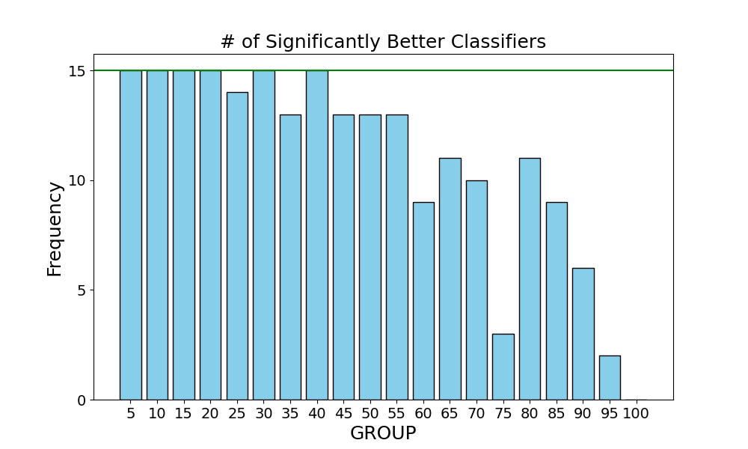

Slide 6
Best KNN Classifier for hours_played
Report performance on my test set

Slide 7
Random Forest Parameters
Four Legacy Groups
Continuous All– 'helpful','funny','polarity','objectivity','n_words','n_sentences'
Vote count– 'helpful','funny'
TextBlob– ‘polarity’,'objectivity'
TextBlob extra– ‘n_words’,‘n_sentences’,‘polarity’, 'objectivity'
Nine hopeful groups
game_name, overall_player_rating
publisher, overall_player_rating
developer, overall_player_rating
game_name, publisher, developer, overall_player_rating
recommendation, game_name, overall_player_rating
recommendation, publisher, overall_player_rating
recommendation, developer, overall_player_rating
recommendation, game_name, publisher, developer, overall_player_rating
All categorical AND continuous features.
Ensemble 100 trees
Max Features = # features
Criterion
Entropy
Gini
Log
Random
Target Disc
Frequency
Equal range on
log(hours_played)
Notes:
Polarity, objectivity
Just one hot them
All other values are just fine as is.
Euclidean_dist –
½ (||x - y||)^2 – onehot
Onehot or continuous mask
Euc dist norm. Can take the norm difference of a single element. Forbenius norm (1 norm). row sum | x-y |
Mean =
Std_error =
normalize inside euc dist method.

Slide 8
Random Forest Analysis– Target Disc. and Split Criterion
Target Disc | # pass t-tests Max = 52
Frequency | 49
Equal Range on log(hours_played) | 0
Additional split criterion analysis
Split Criterion | # pass t-tests Max = 26
Entropy | 11
Gini | 12
Log | 13
Random | 13
Almost no variation in the # of passed t-tests are accounted for by the criterion choice

Slide 9
Random Forest Analysis– Pairwise T-Test on Feature Subsets
Max = 8
 | 1. | 2. | 3. | 4. | 5. | 6. | 7. | 8. | 9. | All Continuous | Textblob | Textblob Extra | Vote Count
1. | 0 | 4 | 2 | 0 | 2 | 0 | 2 | 1 | 8 | 8 | 8 | 8 | 8
2. | 0 | 0 | 1 | 0 | 1 | 0 | 1 | 2 | 8 | 8 | 8 | 8 | 7
3. | 0 | 2 | 0 | 0 | 1 | 0 | 1 | 1 | 8 | 8 | 8 | 8 | 7
4. | 0 | 4 | 0 | 0 | 0 | 0 | 0 | 1 | 8 | 8 | 8 | 8 | 7
5. | 3 | 4 | 5 | 2 | 0 | 2 | 2 | 2 | 8 | 8 | 8 | 8 | 8
6. | 0 | 4 | 0 | 0 | 1 | 0 | 1 | 1 | 8 | 8 | 8 | 8 | 7
7. | 0 | 4 | 1 | 0 | 0 | 0 | 0 | 0 | 8 | 8 | 8 | 8 | 8
8. | 1 | 4 | 4 | 2 | 0 | 3 | 0 | 0 | 8 | 8 | 8 | 8 | 7
9. | 0 | 0 | 0 | 0 | 0 | 0 | 0 | 0 | 0 | 7 | 5 | 7 | 4
All Continuous | 0 | 0 | 0 | 0 | 0 | 0 | 0 | 0 | 1 | 0 | 3 | 2 | 0
Textblob | 0 | 0 | 0 | 0 | 0 | 0 | 0 | 0 | 0 | 3 | 0 | 4 | 0
Textblob Extra | 0 | 0 | 0 | 0 | 0 | 0 | 0 | 0 | 1 | 2 | 1 | 0 | 0
Vote Count | 0 | 0 | 0 | 0 | 0 | 0 | 0 | 0 | 4 | 8 | 8 | 8 | 0

Slide 10
Best parameters to predict recommendation
Train random forest on categorical feature subsets
Add with/without hours_played
Group = 10, 20, 30
Target is already discretized
Test 4 split criterions

